Slide 1
Azure Database for PostgreSQL
Srini Alavala
Cloud Solution Architect
Microsoft

Slide 2
PostgreSQL is more popular than ever
One of the most loved and wanted databases in Stack Overflow’s 2019 Developer Survey
Ranked 2017 and 2018
DBMS of the Year
by DB-Engines
https://insights.stackoverflow.com/survey/2019?utm_source=so-owned&utm_medium=blog&utm_campaign=dev-survey-2019&utm_content=launch-blog
https://db-engines.com/en/blog_post/76

Slide 3
Oracle to PostgreSQL | Cost of Ownership
Customers migrate from Oracle to Azure database for PostgreSQL to reduce overall cost of ownership by up to 95% in savings*
 | Oracle Database Cloud Service Enterprise Edition | Oracle Database Cloud Service Enterprise Edition High Performance | Oracle Enterprise Edition | Azure Database for PostgreSQL
Database | $9,599 / month | $19,801 / month | $47,500* / per CPU | $2,046.34 / month
Virtual Private Database | Included | Included | Included | Row level security
Partitioning | Not included | Included | $11,500* / per CPU | Included
Data Guard | Not included | Not included | $11,500* / per CPU | Included
Spatial | Not included | Included | $17,500* / per CPU | Included
Diagnostics | Included | Included | $7,500* / per CPU | Included
Tuning Pack | Included | Included | $5,000* / per CPU | Included
Lifecycle Management Pack | Not included | Included | $12,000* / per CPU | Included as part of OSS tool suite
Total Capex | $0 | $0 | $1,800,000* | $0
Annual Support / Maintenance per Server (Opex) | Included | Included | $396,000** | Included
Total 3 Year Cost of Ownership | $345,564 | $712,836 | $3,294,000*** | $73,668
Savings with Azure (approx.) | 80% | 90% | 95% | NA
Estimates Only
Configuration is based on a 4 socket, 32 core x86 possessor Oracle Cloud Service editions are based on virtual machines
*Oracle licensing for Enterprise Edition is based on number of processors which is derived by multiplying the number of cores by a factor. In the case of this example it is 32 cores multiplied by .5 for x86 resulting in 16 processors.
**Annual maintenance and support for Oracle is 22% of the annual license cost.
***Oracle standard terms for Enterprise Edition is 50% of list pricing for 3 years. This example accounts for the 50% list pricing for 3 years in the total.
Project Size? > $200K ADS in FY20-21
*See Notes Section
Notes:
This slide is for discussion purposes only. Please use with discretion. Our team is receiving and implementing feedback to make this more consumable.

Slide 4
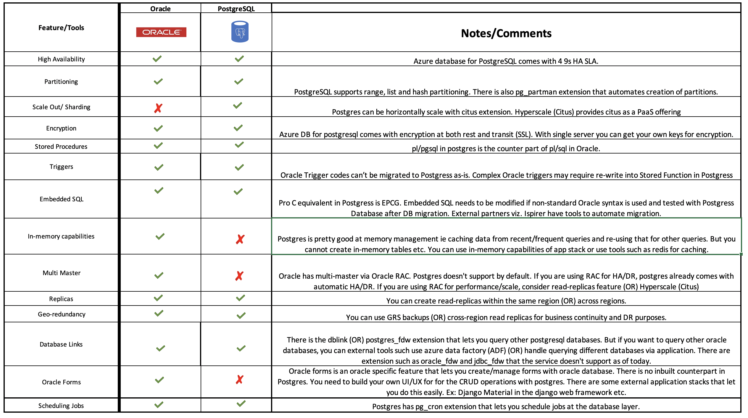
Feature Comparison Matrix
Notes:
Next Steps:
Scalable tooling motion. Work with Ashok, Pavel, Arun, Sai and create a story around in-house tooling.

Slide 5



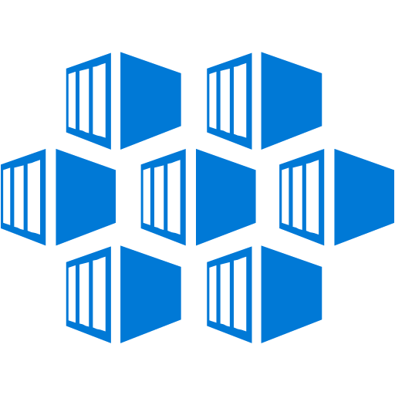

Azure Database for PostgreSQL | Value
Fully managed OSS community databases on MySQL, PostgreSQL, MariaDB
Best total cost of ownership
with built in HA
Enterprise scale with Hyperscale
Scale PostgreSQL databases across 100s of nodes with Hyperscale
Secure and compliant with Advanced Threat Protection and Azure IP Advantage
Built-in intelligence optimizes performance and security
Integrates Azure services
with streamlined provisioning and management experience for common OSS frameworks and languages
Easy migration
Enterprise-ready
Developer productivity

Slide 6
Focus on your application, not your database
On-premises
PostgreSQL
IaaS
Azure VMs with PostgreSQL
PaaS
Azure Database for PostgreSQL
Intelligent performance/security
Applications
Applications
Applications
Data
Data
Data
High availability /DR/Backups
High availability /DR/Backups
High availability/ DR/Backups
Database provision/ Patch/Scaling
Database provision/ Patch/Scaling
Database provision/ Patch/Scaling
O/S provision /patching
O/S
O/S
Enterprise-grade managed services for PostgreSQL
Virtualization
Virtualization
Virtualization
Hardware
Hardware
Hardware
Datacenter management
Datacenter management
Datacenter management
Machine learning capability
Managed by customer
Managed by Microsoft

Slide 7

Azure builds upon the core benefits of PostgreSQL
Security
Intelligent performance
Global reach
Extensions
Compliance
Rich indexing
JSONB
Scale up & out
Geospatial support
Full text search
Extension support
Azure Database for PostgreSQL is fully-managed, community PostgreSQL
Easy ecosystem integration
Built-in HA

Slide 8
The benefits of Azure Database for PostgreSQL
Build or migrate your workloads with confidence
Fully managed and secure
Intelligent performance optimization
Flexible and open
High performance scale-out with Hyperscale (Citus)
Focus on your apps while Azure manages resource-intensive tasks, supports a large variety of Postgres versions and provides best-in industry indemnification coverage
Improve performance and reduce cost with customized recommendations
Stay productive with your favorite Postgres extensions and leverage Microsoft’s contributions to the Postgres community
Break free from the limits of single-node Postgres and scale out across 100s of nodes
Single Server
Hyperscale (Citus) ^{NEW}

Slide 9
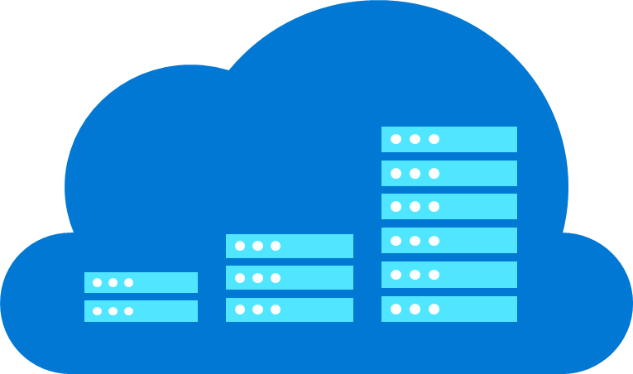
Build on a fully-managed database service with built-in high availability and security
Automatic updates and built-in HA
Scale in seconds
Built-in compliance and security
Azure IP Advantage
Azure ensures your data is available and automatically updates your database, freeing you to focus on your application
Scale your compute or storage resources independently to meet your application’s needs
Automatically leverage enterprise grade security and compliance; proactively receive security alerts with Advanced Threat Protection
Rest assured that you have best-in-industry uncapped defense and indemnification coverage
Azure Database for PostgreSQL supports a large variety of PostgreSQL versions

Slide 10


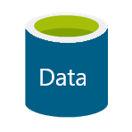
Built-in high availability
Elastically scale your compute up or down
Independently scale up storage as needed seamlessly
Use replicas only if you need to!
Server provisioning and management
Azure Database Management Service
US West
PGSQL IP:5432
Gateway
PostgreSQL Server
Retry
PostgreSQL Server
Application
PostgreSQL Client
Azure Storage
Notes:
Setting-up high availability for database servers is hard, requiring either custom code to manage detection/failover, or expensive 3rd party solutions to make it a bit easier. Worse yet, it’s expensive as typically a second database server (replica) is necessary in order to fail-over in a matter of seconds. A second server = 2x the cost for HA. For AWS customers, you cannot receive a SLA from Amazon on your database server unless you have deployed in a multi-AZ, again meaning 2x the cost.
Azure Database Services is built upon the SQL Database platform which is a Service Fabric-based PaaS solution. As such, rather than having to boot-up an entire OS stack to bring up a new server (such as in IaaS), Azure Database Services run the database engine in a custom container technology which you can think of as a secure “pico process”. The time it takes to bring-up a new server in this custom container is a matter of seconds. This means that in the event that your database server has hung, or “gone away”, the Azure Database Management Service” detects the failure, brings-up a new server in this lightweight container, maps the new IP address to the DNS name of your instance and maps to your storage. This entire process takes between 30-45 seconds. This is built-in to all performance tiers of Azure Database Services and since a replica instance isn’t needed, there is no additional cost to the customers. In contrast, an AWS RDS server that is deployed in a single AZ would take minutes to start – and that does not account for how you would detect the failure and switch-over.

Slide 11
Scale performance on the fly
Scale your server compute up or down in seconds!
Independently scale up storage as needed
Server provisioning and management
Azure Database Management Service
US West
PGSQL IP:5432
Application
Gateway
PostgreSQL Client
PostgreSQL Server
PostgreSQL Server
Azure Storage
Notes:
Leveraging the same technology that powers our High-Availability, Azure Database Services provides the ability to scale performance on the fly with little/no application downtime. Scaling is as simple as literally changing a slider to increase or decrease vCores, and clicking OK. Scaling effectively brings-up a new server at the new performance tier, and switches over to the storage on the previous server and maps to the existing DNS name, all in about 15-20 seconds. This means that customers do not have to worry so much about the size of the server they need coming into Azure. They can choose a SKU to start and then monitor the performance of their database server to determine if they should either scale-up or scale-down their server based on their workload. Customers can then set alerts on metrics such as CPU or Memory usage to notify them in the event they need to scale-up their server for workload spikes.

Slide 12
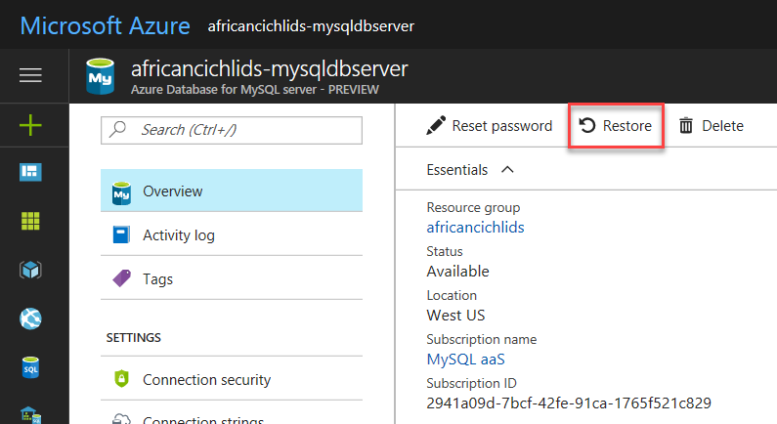
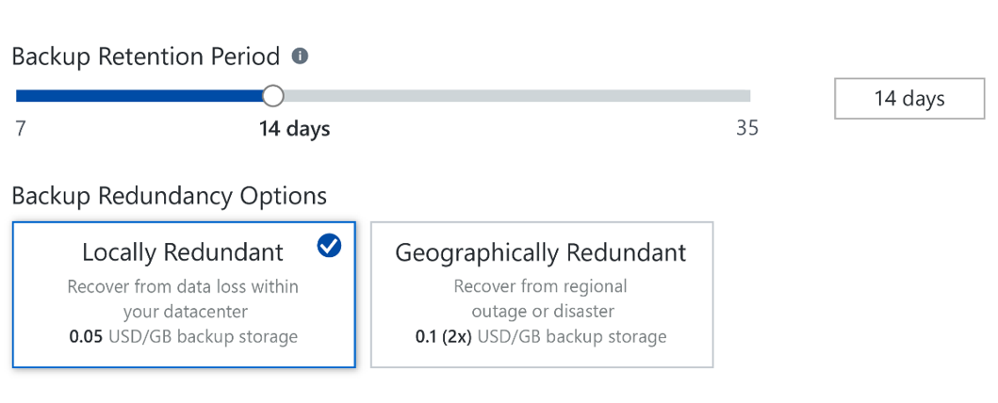
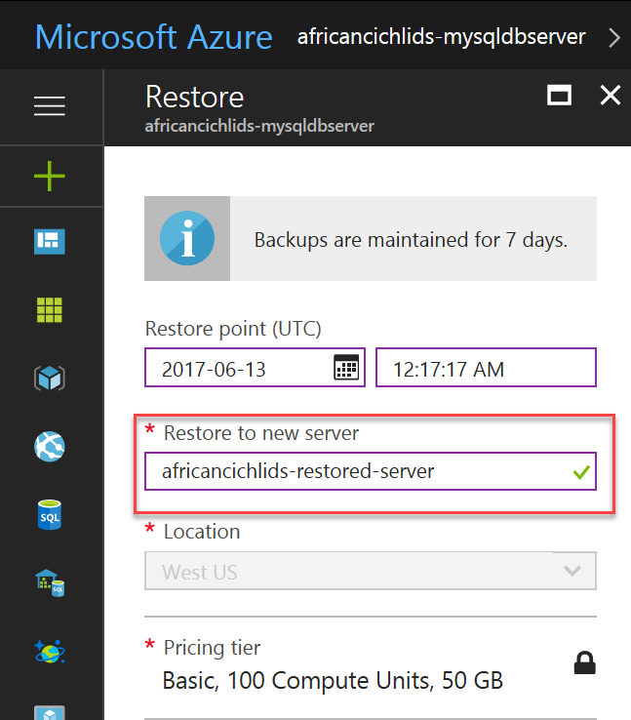
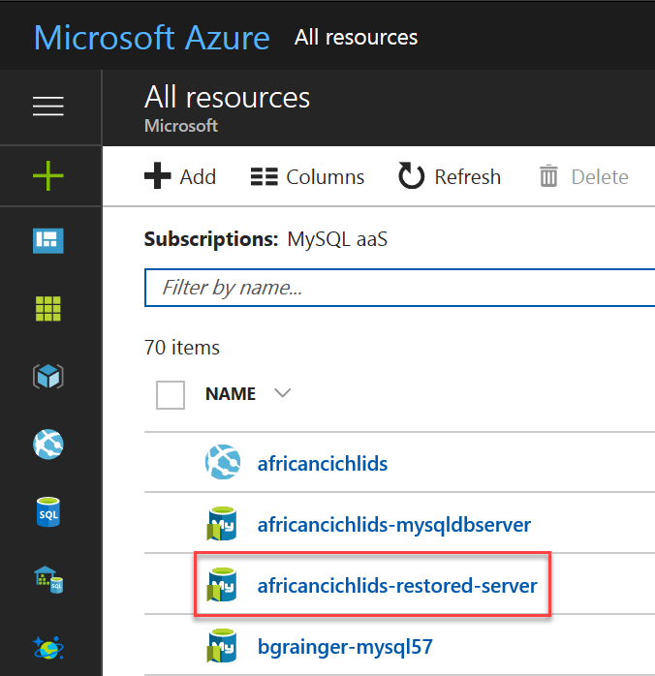
Backup and restore
africancichlids-postgresqldbserver
africancichlids-postgresqldbserver
Built-in backups
Choose LRS or GRS
Restore from geo-redundant backups for disaster recovery (RPO <= 1 hr)
1x Backup storage included
PITR up to 35 days (min. 7 days)
Azure Database for PostgreSQL server
PostgreSQL aaS

Slide 13
Azure Database Migration Service
Azure DMS Overview
Azure Database for PostgreSQL
Oracle to Azure PostgreSQL Conversion Demo

Slide 14
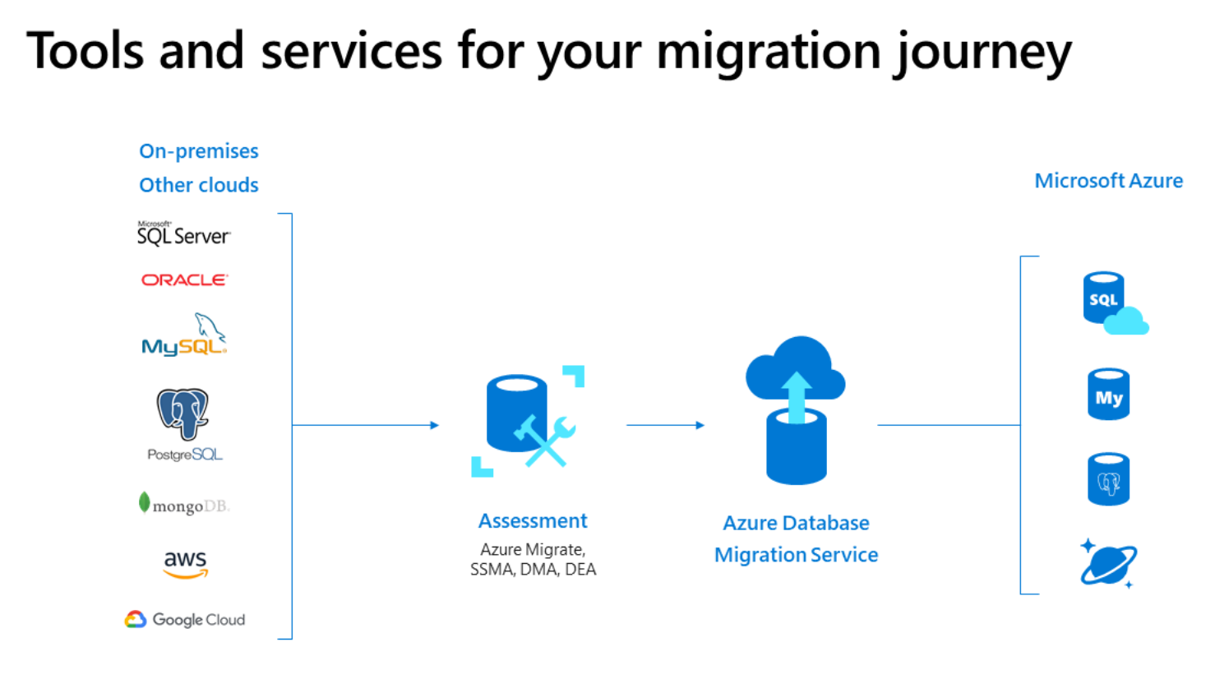

Slide 15
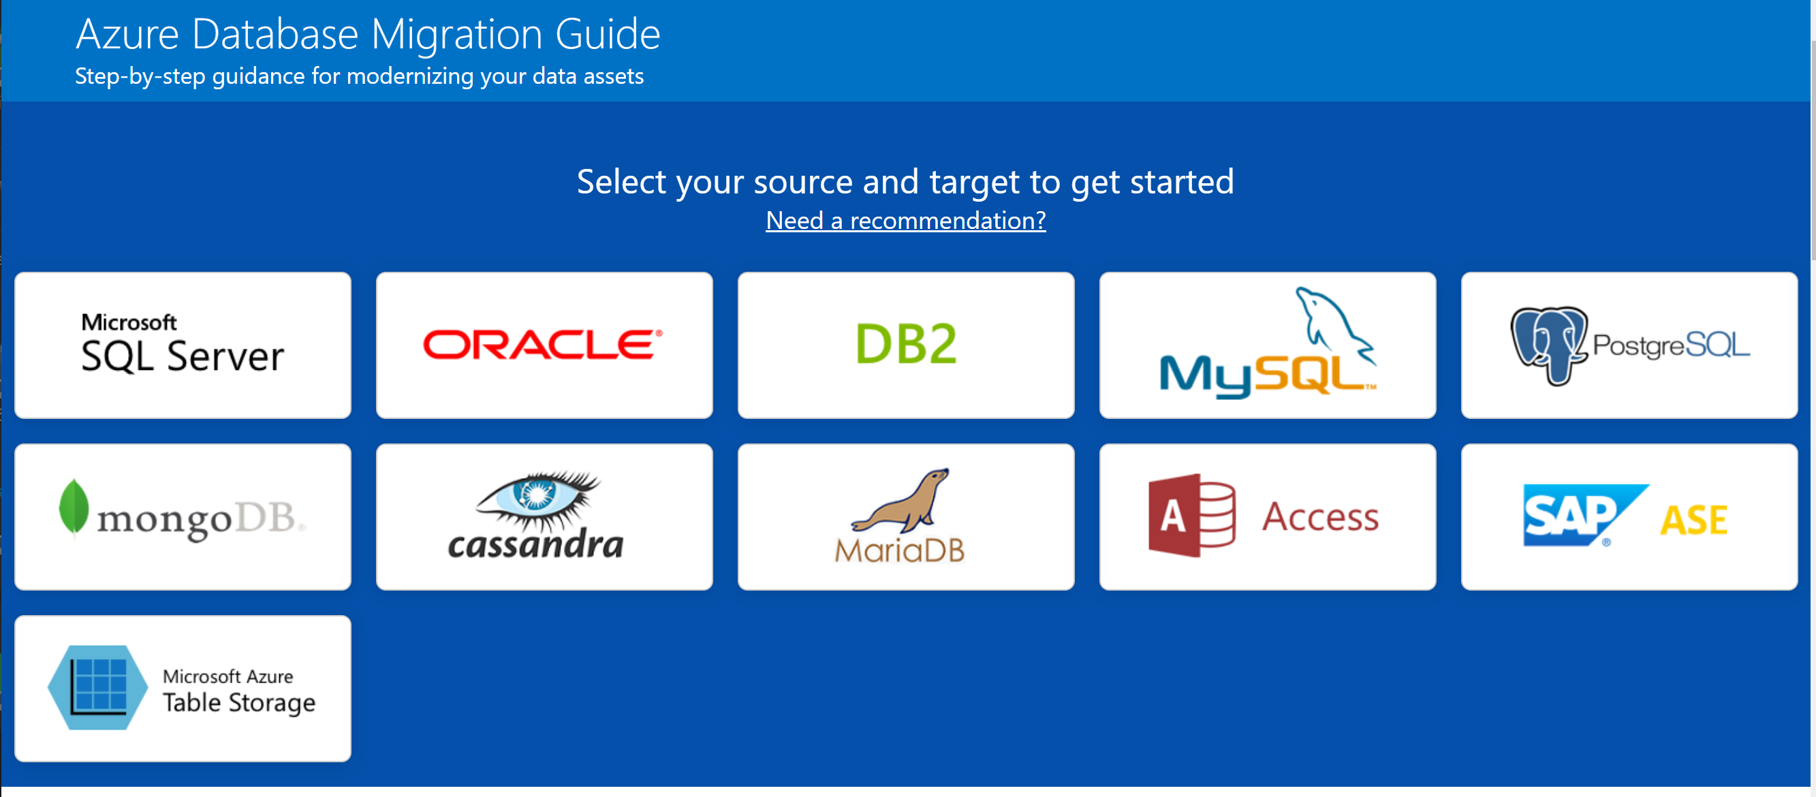
Azure Database Migration Guide https://datamigration.microsoft.com

Slide 16









Migration | Migrating a database
Post-migration
Optimize
Based on the tests you performed, address any performance issues, and then retest to confirm the performance improvements
Pre-migration
Migration
Discover
Assess
Convert
Migrate schema, data & objects
Data sync
Cutover
Remediate applications
Iteratively make any necessary changes to your applications
Inventory database assets, and application stack discovery
Assess workloads and fix recommendations
Convert the source schema to work in the target environment. This is only relevant for heterogeneous migrations.
Migrate the source schema, and then migrate the source data to the target
Sync your target schema and data with the source. This is only relevant for minimal-downtime migrations
Cut over from the source to the target environment. This is only relevant for minimal-downtime migrations
Run functional & performance tests
Iteratively run functional and performance tests
ora2pg
ora2pg
Azure DMS
Striim

Slide 17
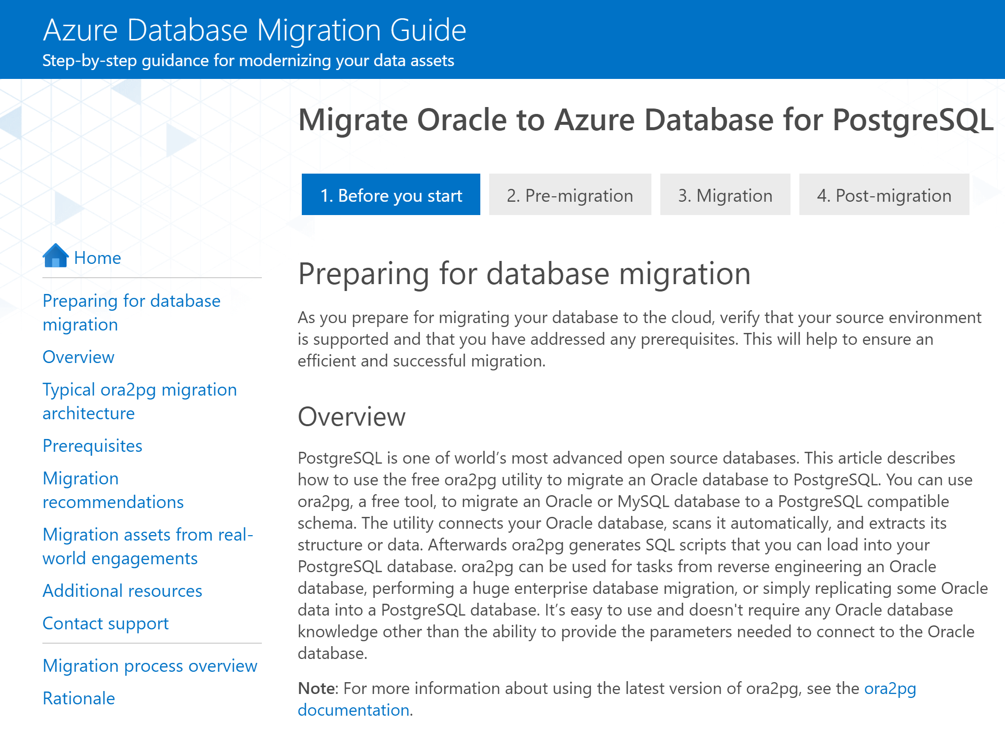

Slide 18
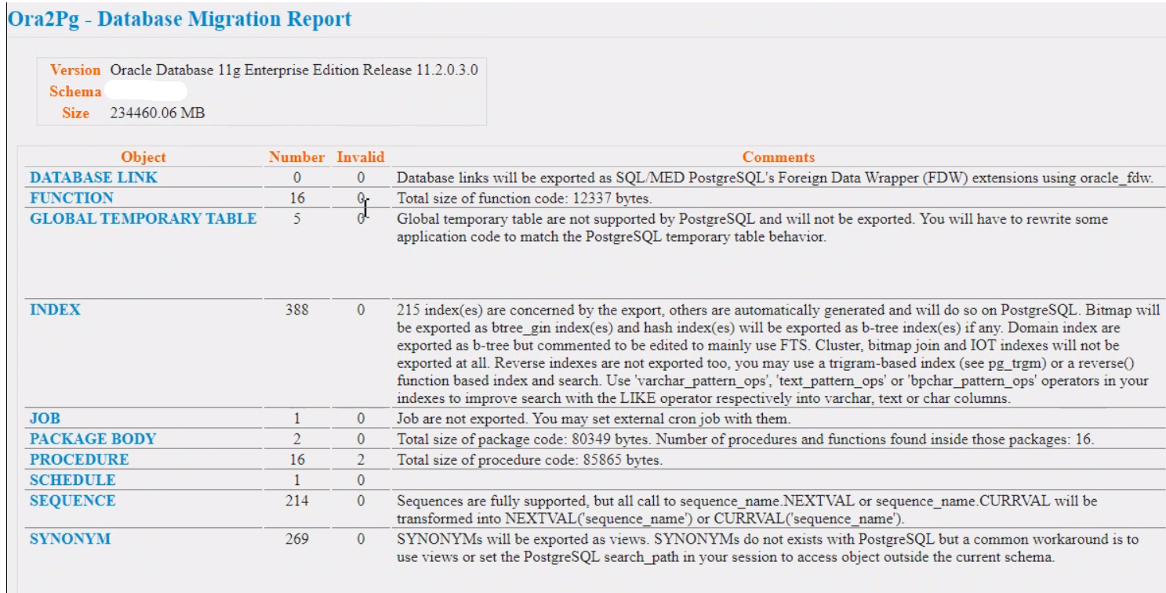

Slide 19
Database Categorization –Reference (How many oracle object counts makes simple, medium, complex) “Start migration from Simple then Medium and finally Complex”. - Helps gradually migrate off Oracle and gain experience from one migration to another.
Sizing Reference / DB | Simple | Medium | Complex
Number of Tables | < 200 | 200-500 | >500
Number of SP/Functions | < 50 | 50-150 | >150
Max lines per SP/Functions | <1000 | <3000 | >3000
Migration Tool (ora2pg) Accuracy | ~80% | 60-70% | 40-50%
Features Vs Complexity Map | Basic data types | ODBC/JDBC connections | No encryption | Tables typically has <1 million rows | DB size < 50 GB | Complex Data Types | Type Casting | Pivots | Pipelines| Caching| Basic Partitioning| Encryption-Data, Table, DB| DB size 50-500 GB | Shared Pool | RAC | Automatic storage management (ASM) | Packages | Sub-functions | In Memory Capabilities | DBLINKS | Complex Partitioning/ distributions/conversion | Replication (MM) |CDC| Third Party apps| Oracle forms | DB size > 1TB | More server level control for ex: downgrading

Slide 20
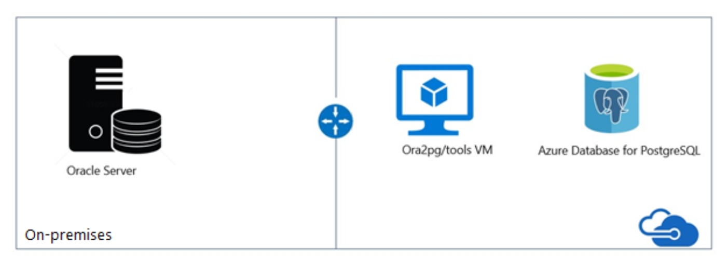
Oracle to Azure PostgreSQL Migration Architecture
Azure Database
Migration Service

Slide 21
Resources for migration
Microsoft Azure
Database Migration Guide http://aka.ms/datamigration
Azure Database Migration Service Migrate with minimum downtime http://aka.ms/get-dms
Sign up for Preview http://aka.ms/dms-preview
Azure Database Migration Service
On-premises workloads
Notes:
Migration guide
Provides prescriptive guidance on how to do migrations. Customers have access to case studies of migrations that other customers already did. Customers will also find a list of partners that they can contact to get assistance to do migrations.
DMS
As organizations look to optimize their IT infrastructure to have more time and resources to focus on business transformation, Microsoft is committed to accelerating these initiatives. The new Azure Database Migration Service (DMS) is a fully managed, first party Azure service that enables seamless and frictionless migrations from heterogeneous database sources to Azure Database platforms with minimal downtime. This service will streamline the tasks required to move existing competitive and SQL Server databases to Azure.
Seamlessly migrate on-premise databases at scale
Experience near zero downtime for mission critical applications
Trust in a robust, resilient service for every migration scenario
Migrate multiple database sources to Azure
*Using DMS to migrate MySQL to Azure Database for MySQL will be at private preview during Azure Database for MySQL GA.
Migrate with minimum migrations
Uploading a large amount of data to the cloud takes some time. Customers cannot always tolerate to stop the application while the database is being migrated. Both DMS and Attunity Replicate For Microsoft Migrations allow customers to migrate with minimum application downtime. The way it works is: while the migration is happening, the data - that users change when using the application- is replicated to the target. The mount of application downtime that customers take is reduced to the time it takes them to points the application to the target (change the connection string, change the definition of the DMS alias…).

